Slide 1
Week 3
Good day to all my parents.
Thank you for everyone’s hard work and patience.

Slide 2

Please remember to send me week 2’s work today.
Please do the work with your child, and help him/her, if the child is going to learn the wrong way he or she is going to do it wrong for the rest of his or her life.
I’m giving feedback, for your child to learn the right ways of doing things, for example: Writing the number 8.
If I am giving feedback please focus on the feedback and make sure your child is going it right.
An example : If you see your child is making a number 8 on the wrong way, please show them my video and make sure your child is exercising the number more than the numbers or alphabet they are getting right.

Slide 3
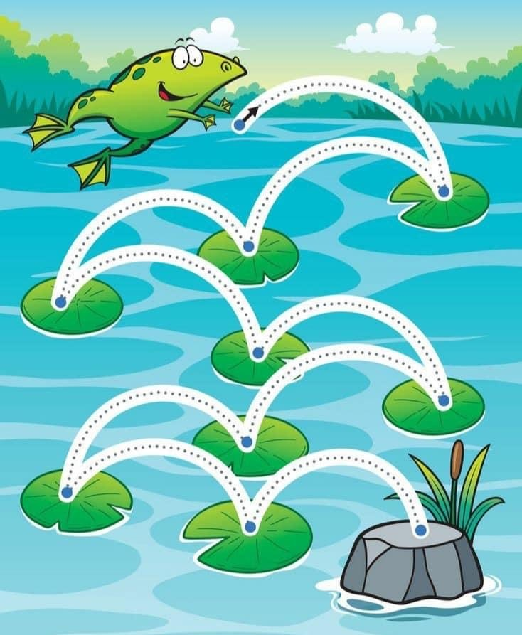
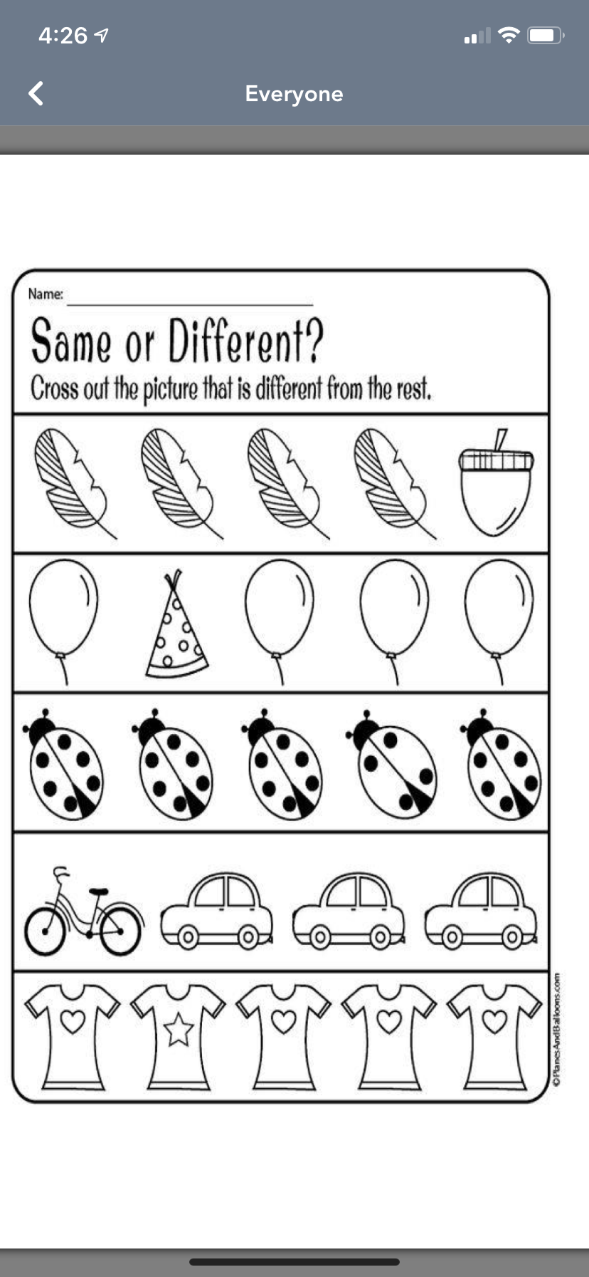
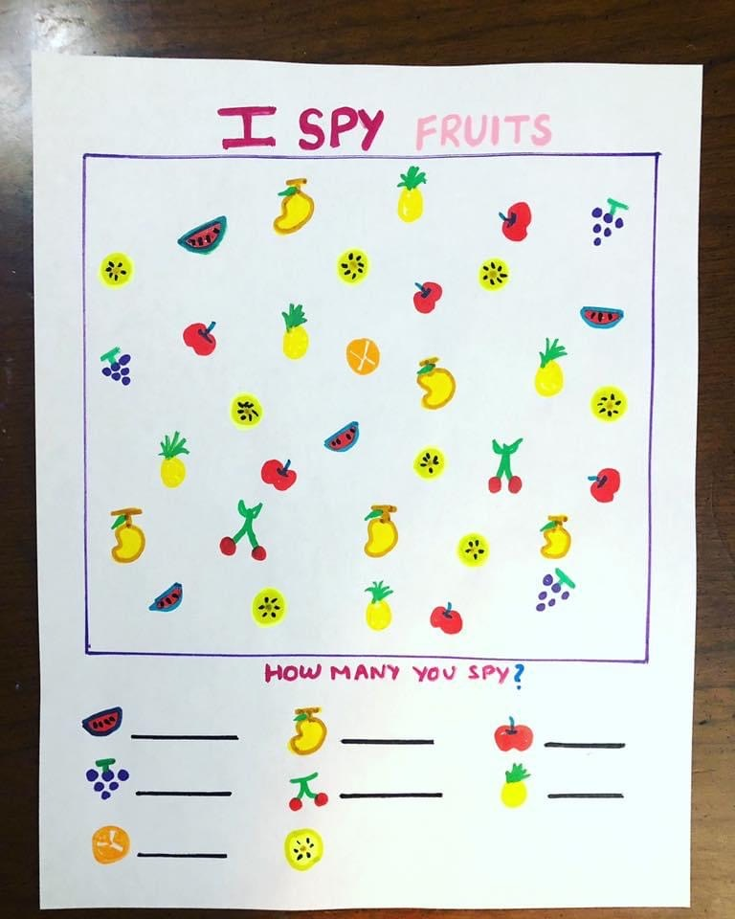
I am going to send you worksheets, here are some examples, if you can not print it out, please make your own, or just show your kid the photo, and let them do the work on a blank paper.
You must do the work, and send it to me, or upload it on the seesaw app, the principal and department of education want to see the work.
You must please exercise the learning file everyday with the work I am giving.

Slide 4
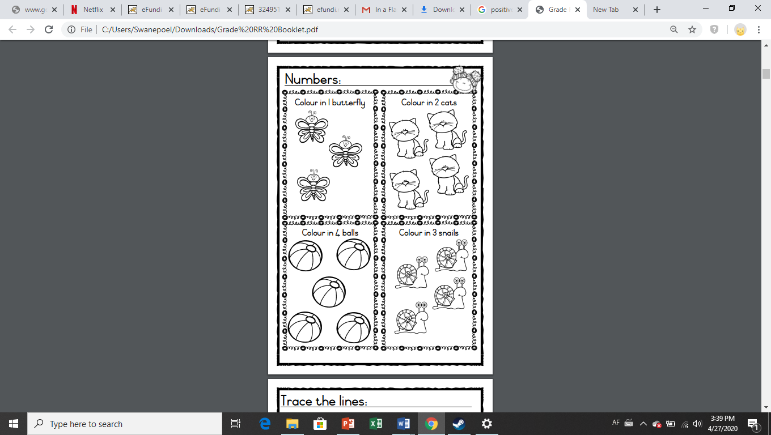
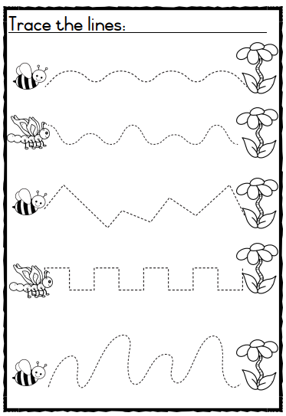
Here are a example or a worksheet, if you cant print the worksheets, please make your own, for example draw 5 hearts, and let them colour in one, two, three and four.
For tracing, you can also draw your own lines, and let your child go over it 5 times, with different colours or the same colour.

Slide 5
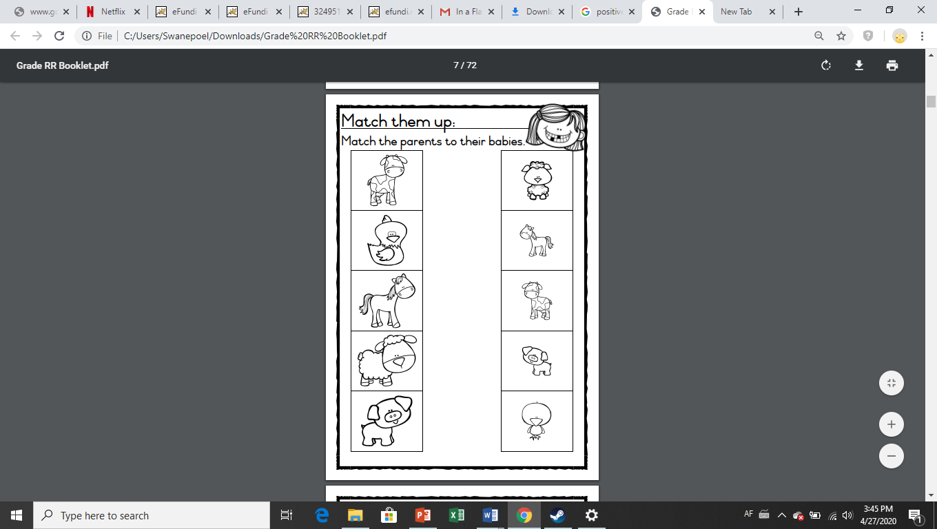
For a exercise like these you can make a video or use your photo editor to draw lines.
I know this is testing your patience, but please we need your child to still learning.
I will send a video by showing how to use your photo editor.

Slide 6
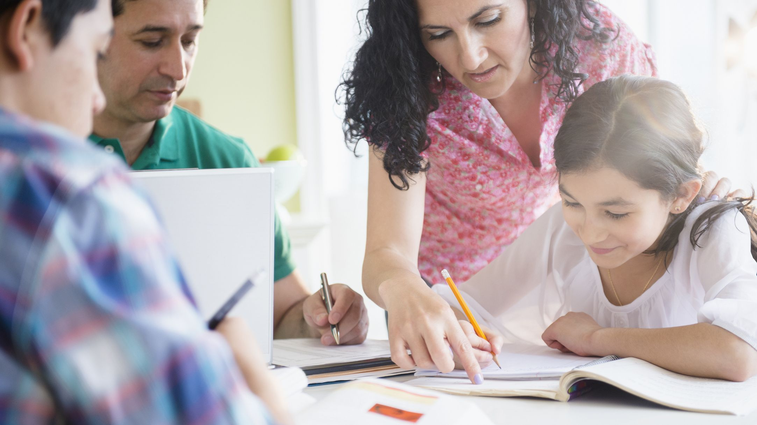

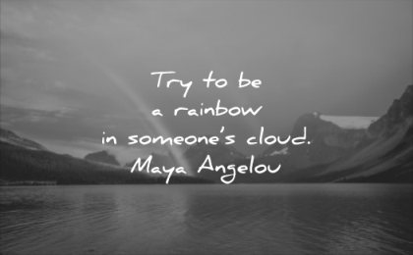
Please let the learners write down the alphabet, and numbers until 20 everyday.
Let them put their fingers on the letters and numbers while counting and singing, a child is learning faster while seeing the letters and numbers.
If you can not print the alphabet of numbers, you can write it yourself on a plane paper, and your child can work from it.

Slide 7
Thank you for everyone’s efforts and patience.
Let us work together to help your child.

